Slide 1
Abnormal detection of Chip Temperature Time Series
GC

Slide 2
Team members
CAO LIANG
GENG LIANGYU

Slide 3
Business objective
During burn-in testing, the heat will be generated at the burn-in board, and the temperature of chip on the burn-in board detected by sensor will be increased over the testing time
The abnormal chip temperature during the testing period will have different pattern comparing with normal chip
Normal chips will have a pattern of increasing temperature over time, due to the continuous heating of the oven, and faulty chips will have a different temperate pattern
Faulty chips will be identified by using the abnormal temperature pattern detection

Slide 4
Burn-In Test
Burn-in Test
Check the reliability of chips
Burn-in boards are inserted into the burn-in oven which supplies the necessary voltages to the samples while maintaining the oven temperature

Slide 5
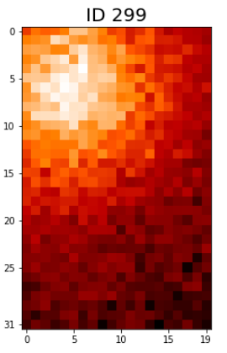
Burn-In Board
Burn-in Board
It is used as part of the reliability testing process during which components are stressed to detect failures
It consist of sockets to accommodate the tested chips and are designed to withstand the hot temperatures during tests

Slide 6
Technical objective
Create model to perform unsupervised anomaly detection on temperature data
Label chip as normal or faulty based on model output

Slide 7
Resources
Dataset
Masked data based on the original data from semi-conductor factory
Contains sensor temperature data inside IC chip
Obtained during burn-in test interval under similar testing environment
Contains 400 burn-in board, and each board contains 32 x 20 chips
Each chip has 20 temperature reading in 10 minutes interval

Slide 8
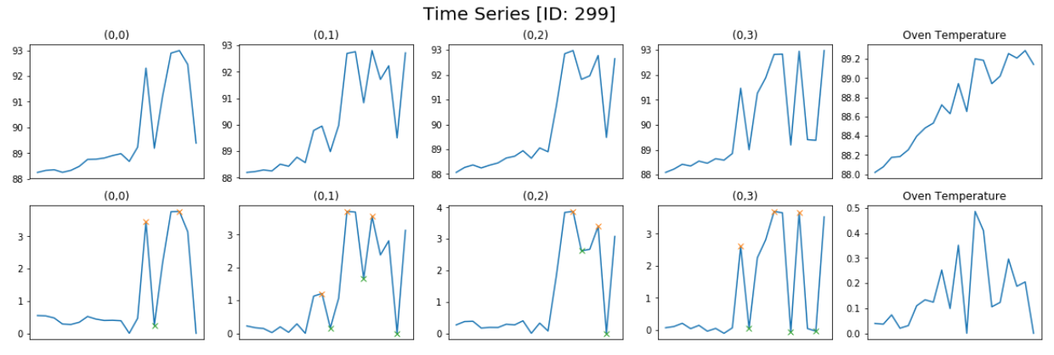
Resources
Dataset

Slide 9
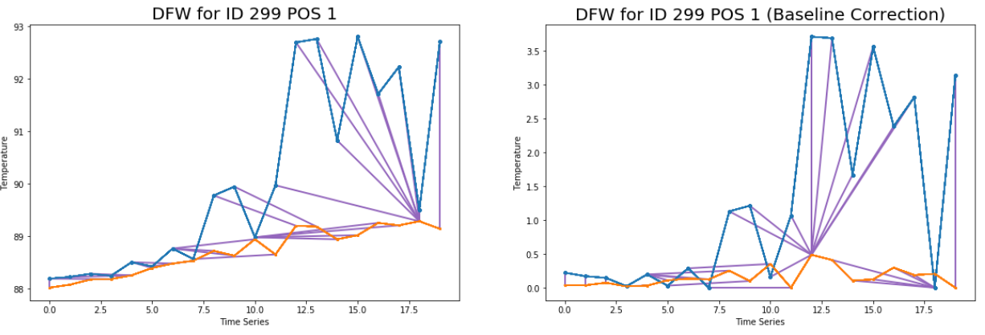
Resource
Dataset

Slide 10
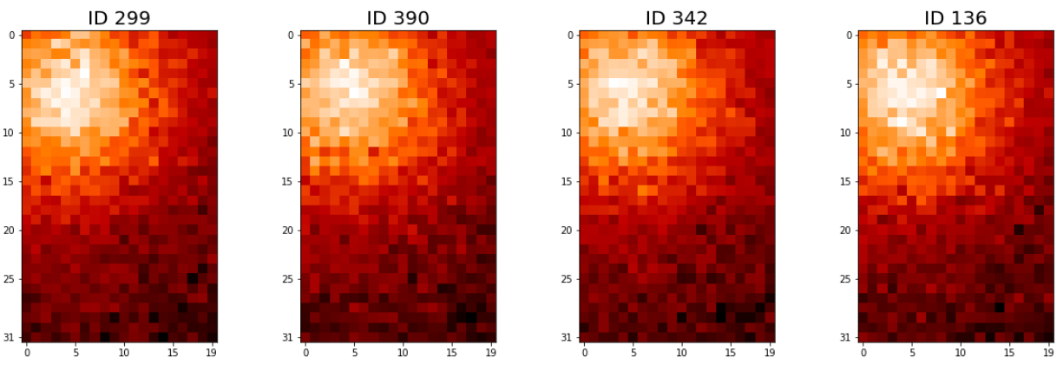
Resource
Dataset

Slide 11
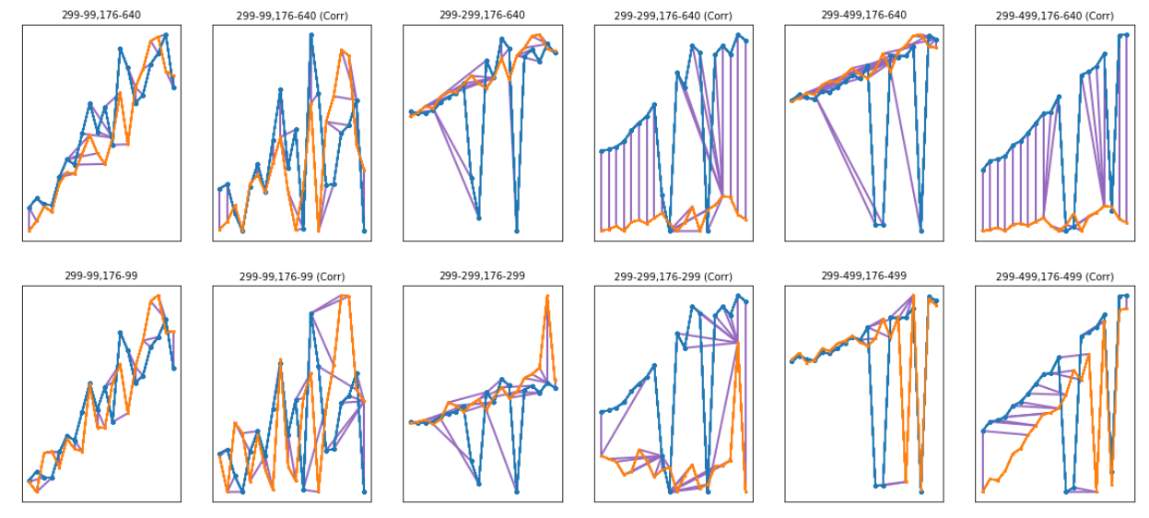
Resources
Dateset

Slide 12
Proposed Approach
Implement unsupervised anomaly detection on temperature time series data
Temperature time series data will be generated by sensor
Train an auto-encoder on the training temperature data
Evaluate it on the validation temperature data and the reconstructed error plot
Choose the threshold and determine the value is abnormal or not
Label chip as faulty if abnormal value is detected

Slide 13
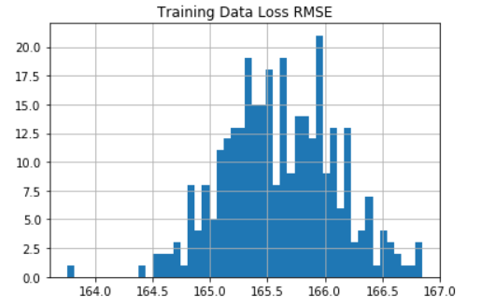
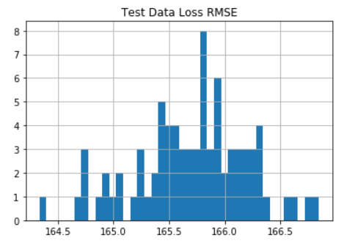
Testing
Training Data Loss RMSE
Threshold 166.7
Test Data Loss RMSE

